Slide 1

MEMORIES
DEPARTMENT OF COMPUTER ENGINEERING AND APPLICATIONS
Institute Of Engineering and Technology
SUBMITTED BY-
ADITI AGRAWAL
MAYANK GOYAL

Slide 2
Problem statement
This project is to make a full stack web application based on MERN technology which will help users make cards of their memories.
DESIGN
LOGO
HIGH QUALITY IMAGES
CONTACT INFORMATION
SOCIAL MEDIA HANDLES
ABOUT SECTION
SERVICES

Slide 3
Introduction
The App is called "Memories" and it is a simple social media MERN application that allows users to post interesting events that happened in their lives.

Slide 4
Objective
Objective of this project is to make a full stack web application based on MERN technology that allows users to post interesting events that happened in their lives.

Slide 5
Technology Used
HTML: HTML stands for Hyper Text Markup Language.HTML is the standard markup language for creating Web pages.HTML describes the structure of a Web page.HTML consists of a series of elements.HTML elements tell the browser how to display the content
CSS:CSS stands for Cascading Style Sheets.CSS describes how HTML elements are to be displayed on screen, paper, or in other media.
JAVASCRIPT: JavaScript is a web-based scripting language that has been widely used in web application development. In particular, it is often used to add a variety of dynamic functions to web pages, providing users with a smoother and more pleasing browsing experience.

Slide 6
BOOTSTRAP : Bootstrap is a free and open front-end framework for designing websites and web applications. It contains HTML - and CSS -based design templates for typography, forms, buttons, navigation and other interface components, as well as optional JavaScript extensions.
REACT : React (also known as React.js or ReactJS ) is an open-source, front end, javascript library for building user interface or UI components. It is maintained by Facebook and a community of the individual developers and companies. React can be used as a base in the development of single-page or mobile applications.
FONT AWESOME : Font Awesome is a font and icon toolkit based on CSS and LESS. It was made by Dave Gandy for use with Twitter Bootstrap, and later was incorporated into the Bootstrap CDN. Font Awesome has a 20% market share among those websites which use third-party Font Scripts on their platform, ranking it second place after Google Fonts.

Slide 7
MongoDB: MongoDB is a NoSQL database where each record is a document consisting of key-value pairs that are similar to JSON (JavaScript Object Notation) objects. MongoDB is flexible and allows its users to create schema, databases, tables, etc. Documents that are identifiable by a primary key make up the basic unit of MongoDB. Once MongoDB is installed, users can make use of Mongo Shell as well
Express JS : Express is a Node.js framework. Rather than writing the code using Node.js and creating loads of Node modules, Express makes it simpler and easier to write the back-end code. Express helps in designing great web applications and APIs. Express supports many middle wares which makes the code shorter and easier to write
Node.js : Node.js provides a JavaScript Environment which allows the user to run their code on the server (outside the browser). Node pack manager i.e. npm allows the user to choose from thousands of free packages (node modules) to download.

Slide 8
Requirements
HARDWARE REQUIREMENTS
Processor: Intel CORE i5 (8th Gen)
Main Memory(RAM) : 4gb
Keyboard : 108 Keys
Mouse : Optical Mouse
Hard Disk : 160 GB
Good Internet Connection

Slide 9
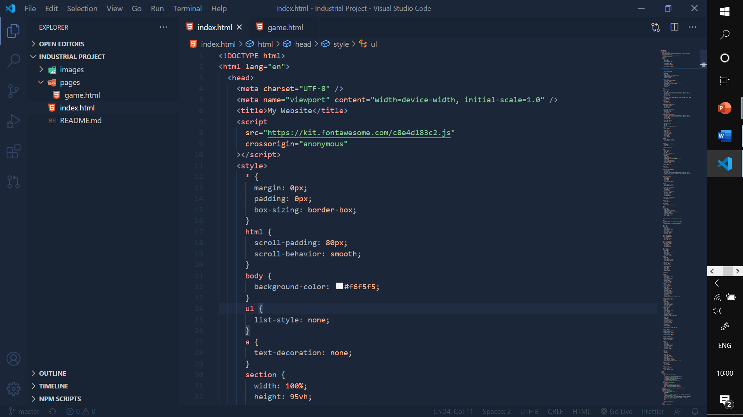
SOFTWARE REQUIRED Visual Studio Code

Slide 10
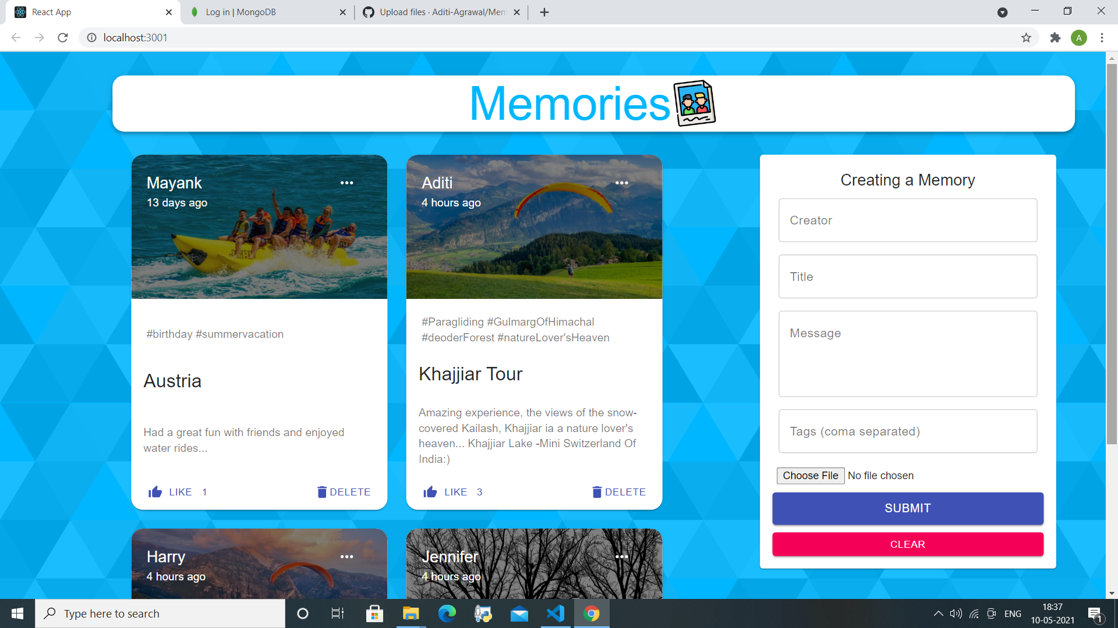
PROJECT SNIPPETS

Slide 11
PROJECT SNIPPETS

Slide 12
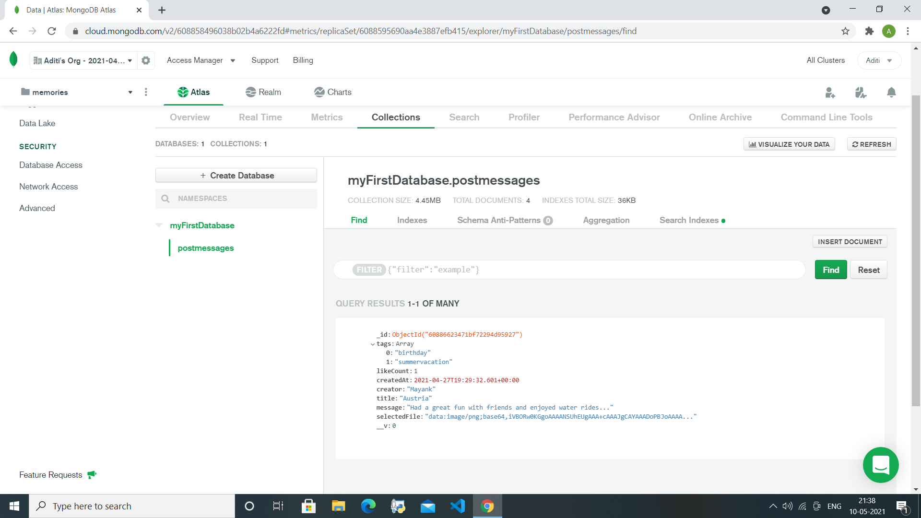
PROJECT SNIPPETS

Slide 13
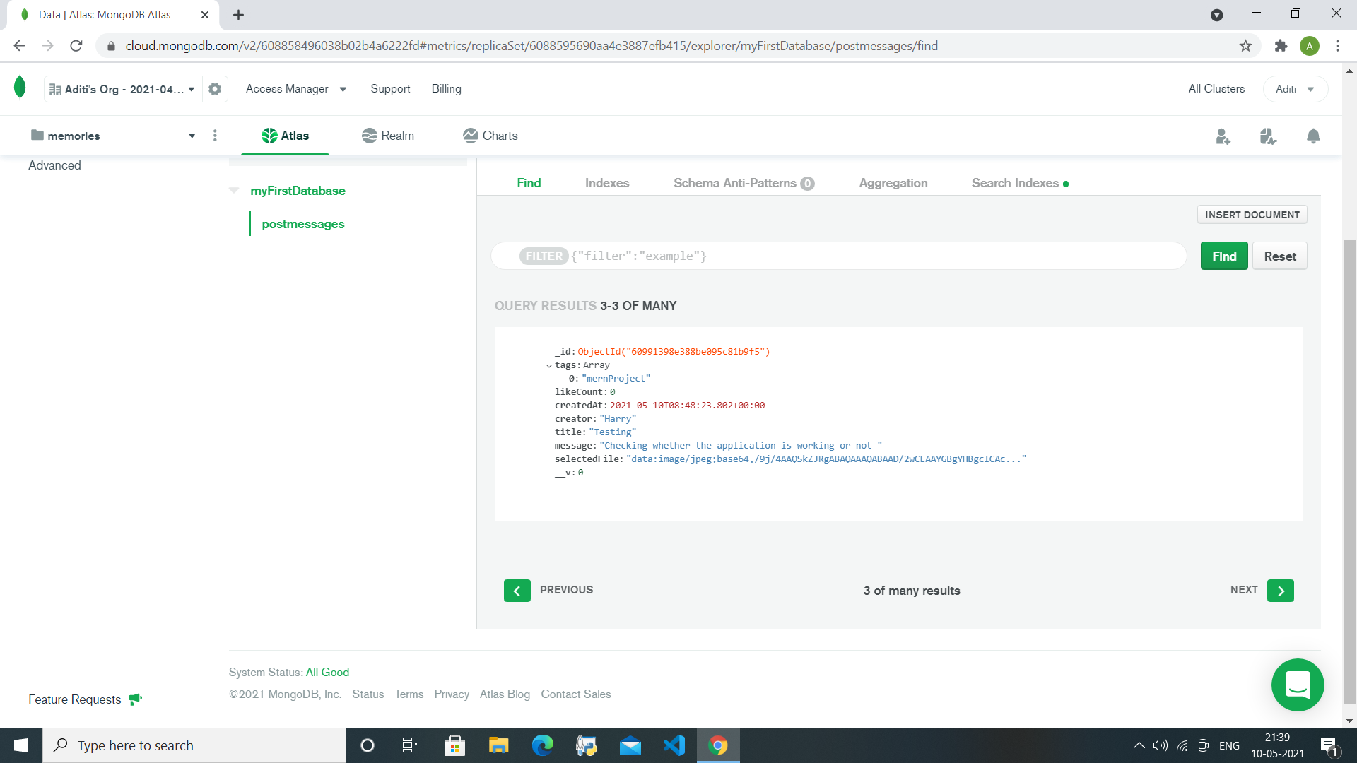
PROJECT SNIPPETS

Slide 14
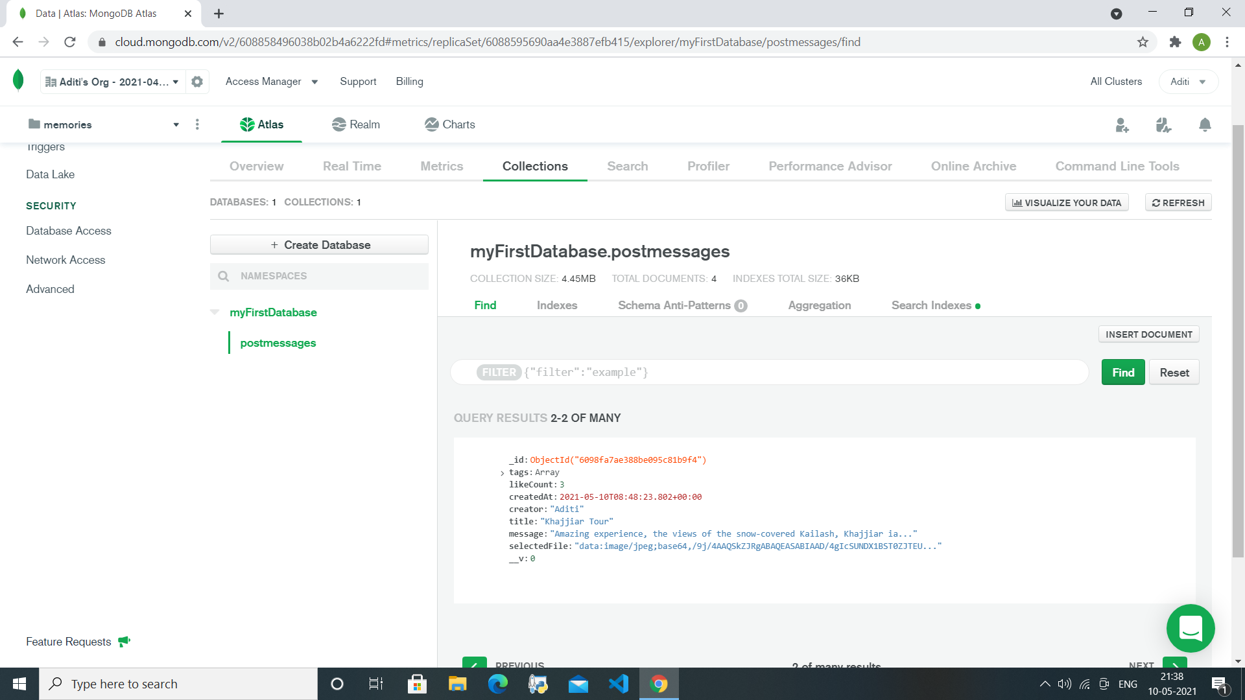
PROJECT SNIPPETS
DATABASE

Slide 15
Thank you.

